Slide 1
Getting Started with
Stock Synthesis

Slide 2
Running Stock Synthesis
1 directory approach
Directory must contain executable + 4 input files
  starter.ss
  Control File (must match name in starter.ss)
  Data File (must match name in starter.ss)
  forecast.ss
Open command line:
  In Windows: Start > Run > type “cmd”
    or Shift & Right-click on folder and choose “Open command window here”
  navigate to directory using cd c:\directory
Run using optimized or safe mode: SS3.exe
Notes:
Download our simpler example

Slide 3
Run Stock Synthesis –
2 directory approach
Create a model user directory in MyDocuments, i.e.
  C:\ MyDocuments\SS_Projects\Test_Runs
Put the DOS program, ss3.bat, and the 4 SS input files in this directory
Edit ss3.bat to refer to the directory containing your copy of SS3.exe
  C:\MyDocuments\Assessments\SSmodel\SS3.exe %1 %2 %3 %4
Open a command prompt in the model user directory
Type ss3 which will start ss3.bat
SS3.bat will open SS3.EXE which then reads starter.ss, then reads the data and control file named in starter.ss, then reads the forecast.ss specification file

Slide 4
Stock Synthesis files
Output for debugging
warning.sso
echoinput.sso
ParmTrace.sso
Input files
starter.ss
MyControlFile.ss
MyDataFile.ss
forecast.ss
Executable
SS3.exe
Output with results
Report.sso
CompReport.sso
covar.sso
Forecast-report.sso
to get comments
or simulated data
Output that mirrors input
starter.ss_new
control.ss_new
data.ss_new
forecast.ss_new

Slide 5
Creating Files
Start from an existing data.ss_new file, which will be heavily annotated by SS, as a template; or start from the SS_data_input.xls spreadsheet
Replace the data content with your data and update the data counters and descriptors
Save as a different filename and insert this new filename in the starter.ss file
Do the same for the parameter file starting from an SS annotated control.ss_new

Slide 6
Associated tools
any text
editor
GUI
Excel
Sheets
Output for debugging
warning.sso
echoinput.sso
ParmTrace.sso
Input files
starter.ss
MyControlFile.ss
MyDataFile.ss
forecast.ss
R4SS
Executable
SS3.exe
Output with results
Report.sso
CompReport.sso
covar.sso
Forecast-report.sso
Excel
Viewer
to get comments
or simulated data
Output that mirrors input
starter.ss_new
control.ss_new
data.ss_new
forecast.ss_new
R4SS
GUI
any text
editor

Slide 7
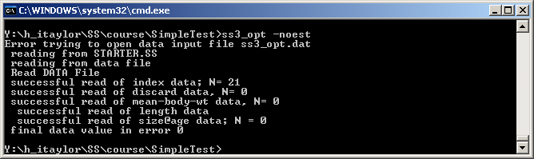
Command line messages
Ignore message: Error trying to open data input file ss3.dat
If you get past Estimating…please wait… then the structure of the inputs is OK.
Volume of information controlled in starter.ss file:
1 # run display detail (0,1,2)
Middle level (1) is usually best.

Slide 8
Stock Synthesis Run
SS then proceeds immediately to pre-processing of the data, creation of internal parameter labels, etc.
  Some checks are written to echoinput.sso
  Problems written to warnings.sso
Then to the Procedure section where iterative parameter changes are made by ADMB to minimize the –logL.
When ADMB achieves convergence, control passes to the sd_phase for calculation of parameter variance (unless –nohess option), then to the benchmark and forecast code section, then to the final reporting.
Results will be written to the same directory as the input files.

Slide 9
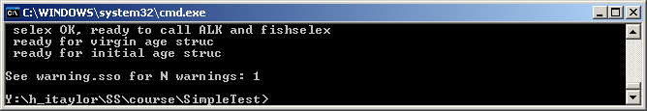
warning.sso file
Contains a list of warnings generated during program execution.
Note in command line if N warnings > 0
Includes
  notification of errors in input files
  some advice on parameter settings

Slide 10
Screen Output at End of Run
5 10 -log(L): 1286.12 Spbio: 49655.1 4982.51
writing big output now
<Hessian would go here>
Finish time: Wed May 11 21:53:27 2011
Elapsed time: 0 hours, 6 minutes, 31 seconds.
Final gradient: 6.54155e-005
Finished writing COVAR.SSO
got Fspr 0.116474 0.4
got_Btgt 0.147638 0.342
got Fmsy 0.105059 3262.56
Do Forecast 2011
Process STD quant
STD OK …….
writing big output now
finished big report
finished summary report
finished rebuilder report
N_nudata: 3
finished nudata report
Write new starter file
Write new forecast file
Write new control file
finished nucontrol report
!! Run has completed !! No warnings
C:\SS2\SS3_Examples\Ver320\Simple>del ss3.r0*

Slide 11
Examine Output
Examine warnings.sso for issues and suggestions
Read output into R4SS or SS_Output-X.xslm to examine the details of the model results
  calculated selectivity, biomass and F time series, numbers-at-age, fit to data, etc.

Slide 12
What to do when it doesn't run?
Look at warnings.sso
Look at echoinput.sso
  work backwards from the bottom
  look for where it doesn't match your inputs

Slide 13
If Input OK, then crash
If model crashes soon after starting run, or if NAN messages appear on screen, then:
Restart SS with the –noest option. This will read files, produce report output, and produce *.ss_new files
Read report.sso and compreport.sso into R4SS or SS_Output-X.xlsm to examine the details.
  May show which likelihood component and which data have the NAN calculation

Slide 14
If SS runs, but large gradient at end
  Re-start from final values in previous run by changing starter file to:
  1 # 0=use init values in control file; 1=use ss3.par
  Examine report.sso for parameters that are on or near bounds
  Examine residuals for gross lack-of-fit. If it is too bad, ADMB may not be able to figure out which way to go!

Slide 15
Bad Hessian
Output file Report.sso includes information on parameter uncertainty
In some cases, Hessian matrix does not invert, and full Report file is not produced.
Run model again using
ss3 –nohess
  (optional) start from final values in previous run by changing starter file to:
  1 # 0=use init values in control file; 1=use ss3.par

Slide 16
Advanced command line options
Options can be added to command line (ADMB)
  Run without estimating anything: SS3 -noest
  Skip standard errors (for quicker results, or to get Report.sso if Hessian does not invert): SS3 -nohess
  Run MCMC:
  SS3 -mcmc 100000 -mcsave 100
  (runs 100,000 draws, saves every 100th)
  SS3 -mceval
  (evaluates saved draws)
  List all command line options: SS3 -?
More info in ADMB Manual (Chapter 12: Command line options) http://admb-project.googlecode.com/files/admb.pdf

Slide 17
Some ADMB secrets
If you receive a memory allocation error
  Try SS3 –ams XXXXXX (i.e., 200000)
  Or free up memory on your computer
If it runs slow
  Probably writing to cmpdiff.tmp & gradfil1.tmp
  Use –cbs XXXXXXX until cmpdiff.tmp=0 Mb
  Use –gbs XXXXXXX until gradfil.tmp=0 Mb
When the model is running:
  Press ‘n’: immediately goes to next phase
  Press ‘q’: immediately quits estimation

Slide 18
Output
Many output files are created
  Report.sso, Forecast-report.sso, …
R4SS can read these files into R
  Creates a list of quantities
  Can create plots

Slide 19
How to get help
User manual
Technical manual
Other models
Other users
SS Google Site
Fisheries Research Special Issue

